Slide 1
Microsoft Goes to the Movies
Data driven recommendations for Microsoft's new movie making venture
Author:
Peter Otieno

Slide 2
Overview
Why Microsoft should enter the movie space.
Which movie genres are currently successful.
Unique offerings by Microsoft in the movie industry.

Slide 3
Business Problem
Microsoft's aim to launch a film/television studio.
Deciding the types of movies to create to be competitive.

Slide 4
Data Sources
Description of the sources:
www.the-numbers.com
www.imdb.com
rottentomatoes.com
Microsoft's acquisition and video game sector informatio

Slide 5
Tools and Methodology
Tools:
pandas and sql for data analysis.
Webscraping from Wikipedia.
Representation of data exploration in individual workspaces (like Workspace_Kyle).

Slide 6
Revenue Insights
Highlight that movie watching is on the rise.
Box office releases trends by month.

Slide 7
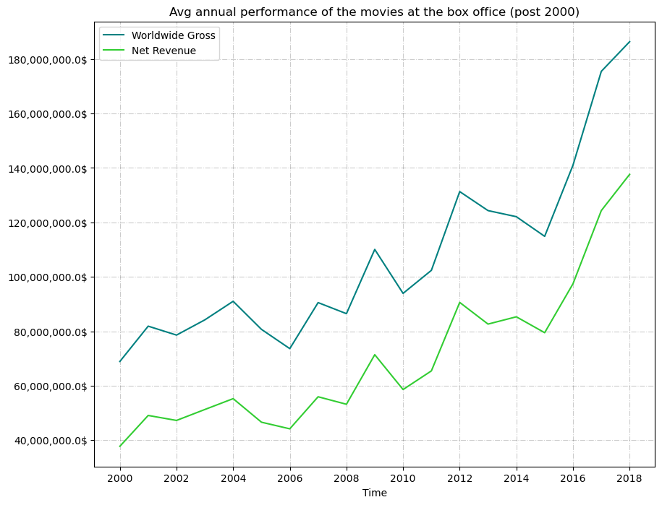
Highlight that movie watching is on the rise.

Slide 8
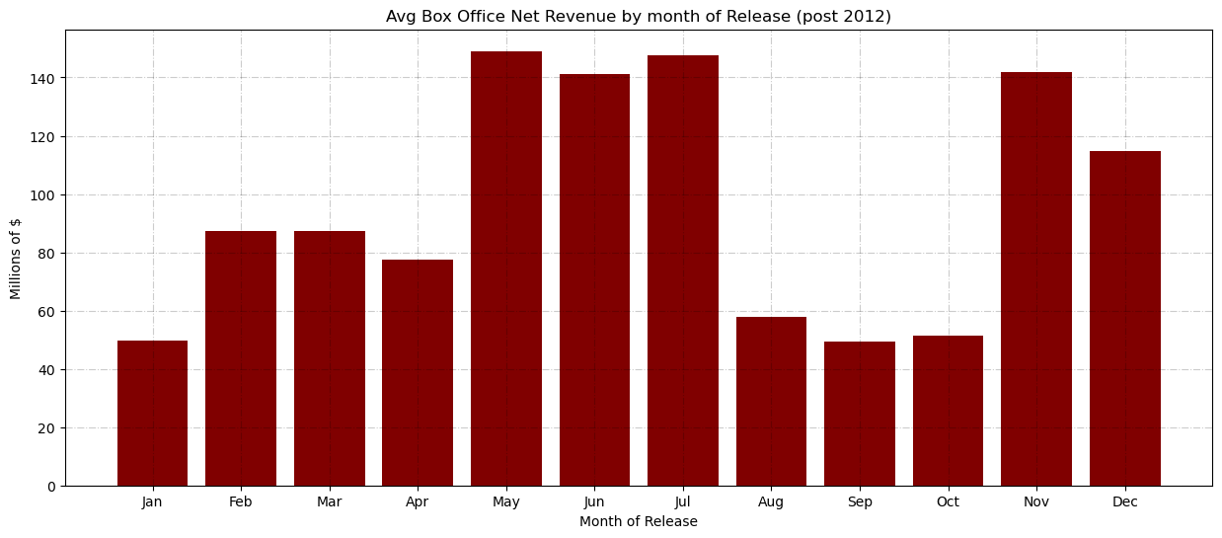
Box office releases trends by month.

Slide 9
Critics and Audience Reception
Data from rottentomatoes.com about genres liked by critics.
Most popular genres with IMDb users.

Slide 10
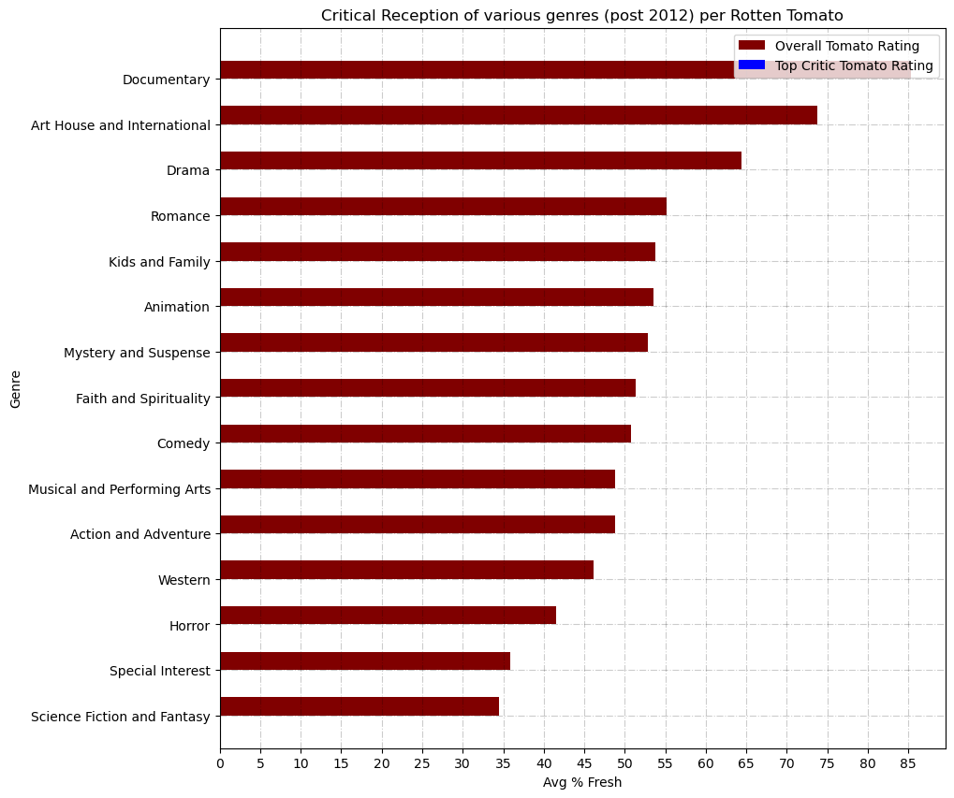
Data from rottentomatoes.com about genres liked by critics.

Slide 11
Recommendations
Leverage the Call of Duty franchise for hard-hitting World War stories.
Bring Halo to the silver screen with a SciFi action movie.
Use Minecraft and Kinect Adventures! for a comedy adventure suitable for all ages.

Slide 12
Conclusions
Movie/Video entertainment is profitable.
Best release times: American summer or winter holidays.
Trends (2010-2019): Popularity in Action/Adventure/Drama movies, with Sci-Fi movies gaining traction from 2015-2019.
Acquisitions like Activision Blizzard enable unique game adaptations.

Slide 13
Next Steps
Identify top writers/directors for these projects.
Delve deeper into Microsoft's game IPs.
Investigate more Microsoft properties for film adaptation potential.

Slide 14
Citations
List of mergers and acquisitions by Microsoft
Xbox Game Studios
Video game sales data from Kaggle.

